Slide 1
Data Analytics Dashboard Projects
By Praneet Mane

Slide 2
Introduction:
To represent various Dashboards made in Excel Spreadsheet Books, we have clubbed some Dashboard work information in this PowerPoint Presentations.
There are minimum 2-3 Dashboards made inside Microsoft Excel Application software.
In this Ppt, we have put some summarized information about each and every company’s data analysis and put on few images for clarity about look and structuring of each Dashboard displayed inside Spreadsheets.
Here are few projects of Excel based Data Analytics projects:
“Hotel Bookings Cancellations.”
“DMart Sales Analytics.”
“Blinkit Grocery Data Analytics.”
“Amazon Sales Dashboard.”

Slide 3
1. Hotel Booking Cancellations:
The Data in Excel sheet has some features (columns) that would help find the actual reasons for hotel bookings cancellations.
We consider columns like arrival date, guest type, room booking status, monthly guests arrival count, total bookings and cancellations year wise.
For this, we can formulate to first find out columns to visualize it in Excel using Charts.
We use Pivot Tables to select particular columns in other Sheet of same Workbook to represent on Charts like Multiple Bar chart, Pie chart, Doughnut chart.
Lastly, we use new Blank Sheet for Visualizing and grouping all charts by connecting each other using Slicer connections on Colored background sheet.

Slide 4
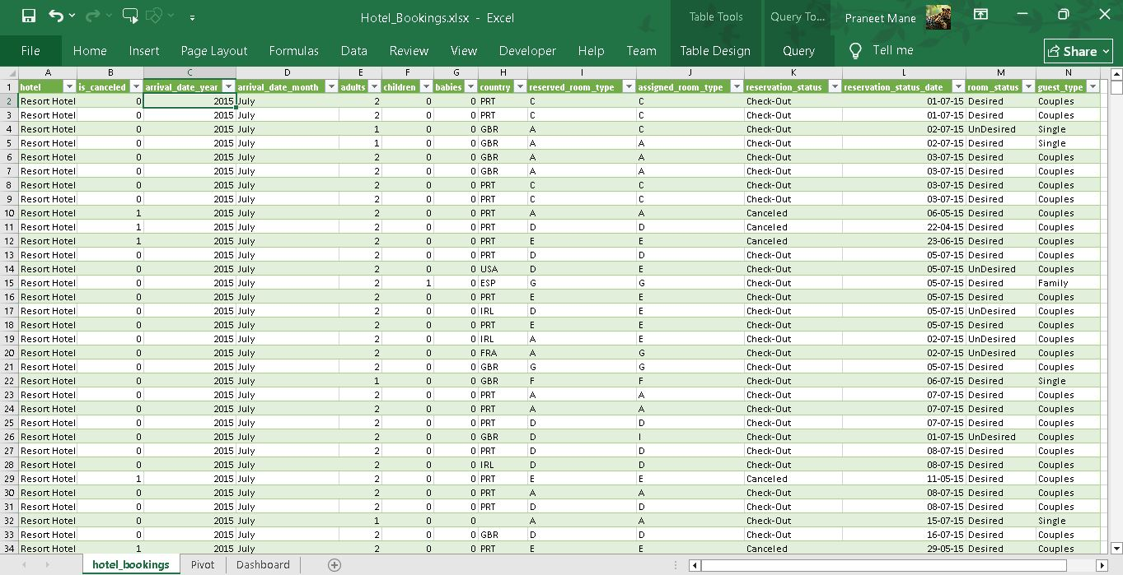
Here we see the Hotel Bookings Data in Excel format as below:

Slide 5
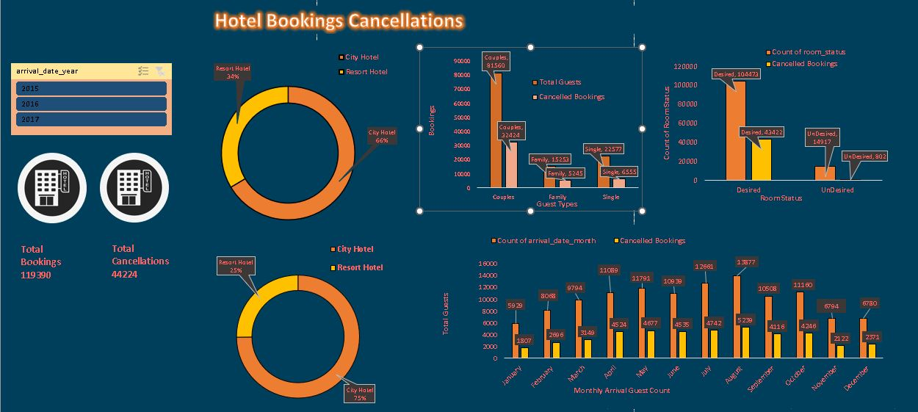
The Dashboard made using given Excel data is as follows:

Slide 6
2. D-Mart Sales and Profit Data Analytics:
D-Mart is in a FMCG Business. Here, we find out Sales and Profit of Grocery section and for few Supermarkets of D-Mart.
We have taken practice dataset of random FMCG business, so we name it as D-Mart Data. Firstly, data is cleaned if required using Power Query or unused columns removed.
We bifurcate our finding as Sales Analytics and Profit Analytics. One of the coloured blank sheet shows Sales data, as per category, region, Shipping mode, segment wise sales.
We add a Slider for adjusting month wise sale insights to slide for particular duration of months.
Also subcategory and state wise sales are taken into consideration. We use mostly Pie charts, Bar chart and some Slicers. All charts are interconnected to slicers and slider.
We take another Blank sheet and show Profit Analytics in same Workbook. We copy down same Slider to this sheet and just add subcategory slicer with bar chart showing the slicer contents.
The profit for each subcategory is shown separately for showing profit numbers clearly. All things are made interconnected.

Slide 7
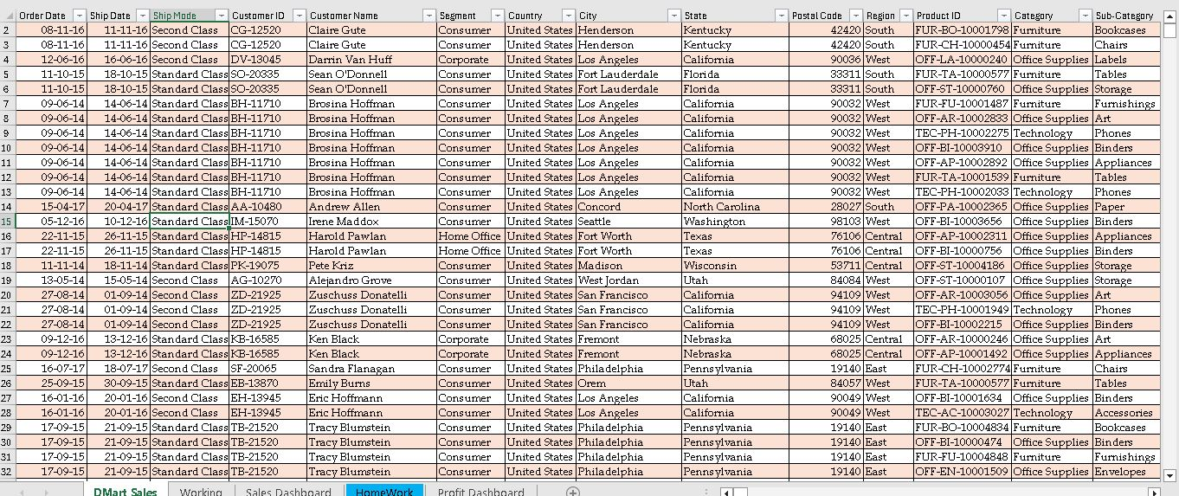
The Excel data available for creating Insights is as below:

Slide 8
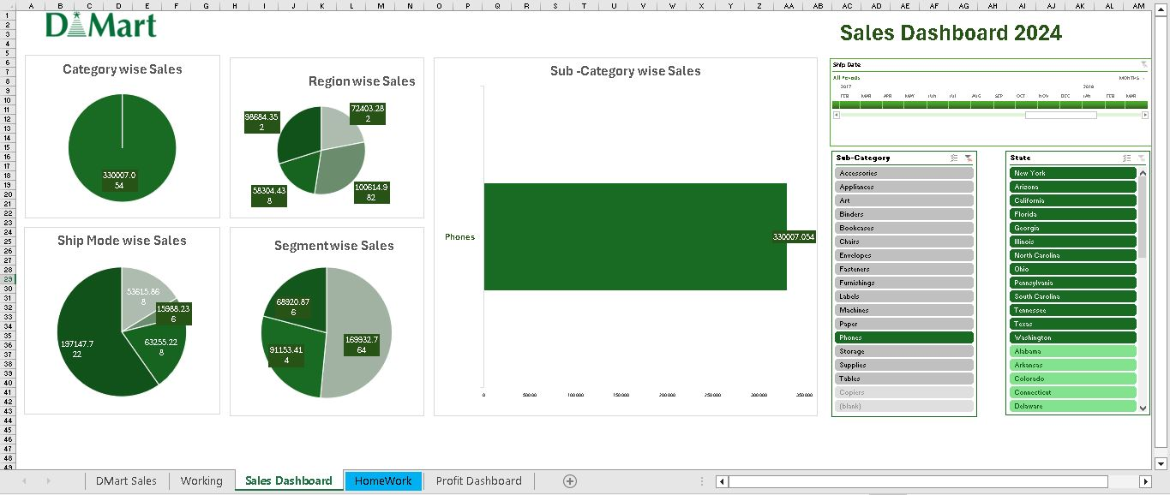
The Dashboard for D-Mart Sales Analytics in Excel :

Slide 9
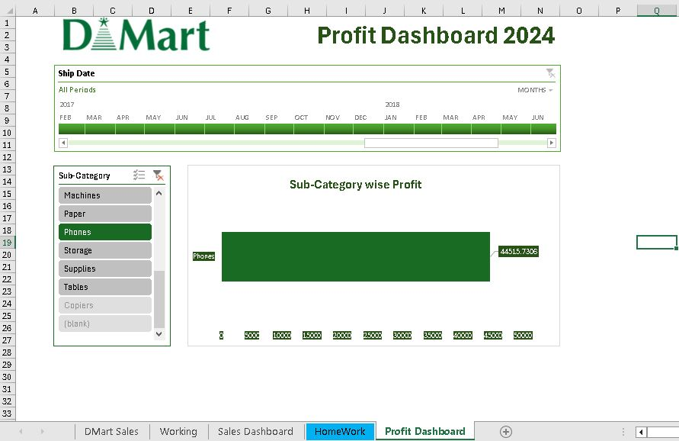
The Profit Analytics for D-Mart Excel data is:

Slide 10
3. Blinkit Grocery Data Analytics:
Blinkit is a Quick Commerce Private Company to deliver daily usable household items with fresh groceries within a few minute’s doorstep anytime online.
Here we Visualize Blinkit Excel Grocery data on basis of Outlet size, Location and item categories.
We also Find out Outlet Size based Total Sales, Average sales for each category type and Count of items and show Fat content in Foods ordered by Doughnut chart for health conscious app users.
Outlet Year wise sales for each item type is plotted on Area chart.
We use Home icon to go into Pivot chart sheet and Database icon for going back to Excel data.
All the charts are interconnected to Pivot charts and Pivot Slicers.

Slide 11
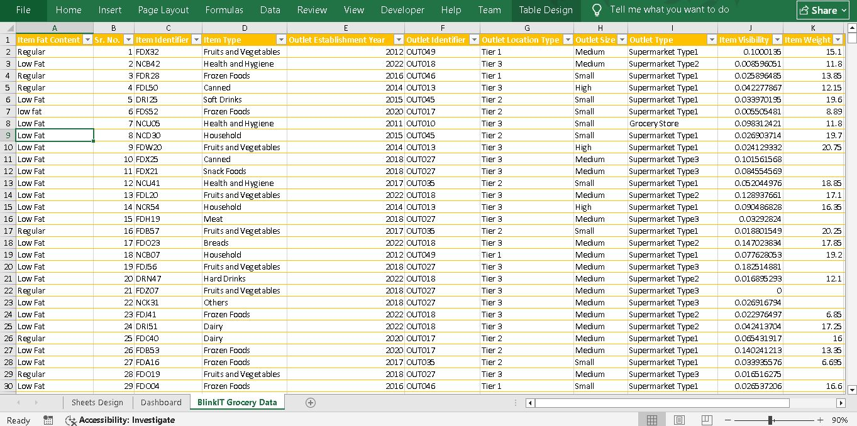
The Excel data with us about Blinkit Grocery Sales and Profit is:

Slide 12
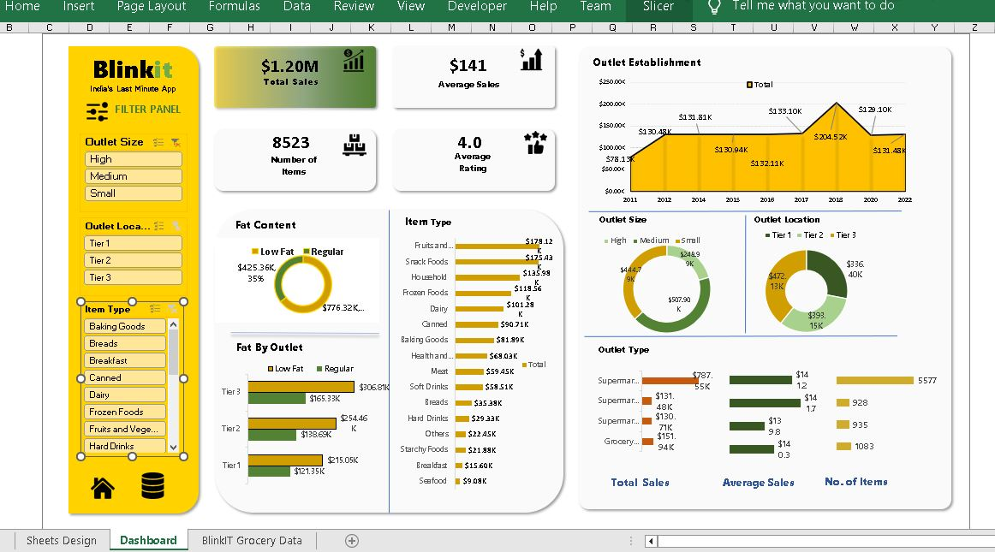
The Resultant Dashboard for Blinkit Grocery Data Analytics as:

Slide 13
4. Amazon Sales Dashboard:
Amazon Sales Dashboard shows Amazon sales data related City wise, State wise, Product wise sales.
We find Units sales and their respective Total Amounts and find out Target with actual to get difference of both entities. We use Pivot Slicers in a Blank Sheet grouped together showing each KPI required.
A Line chart shows Sales data for City wise, a Bar chart shows Product wise Sales and Doughnut charts to show Sales and Units in Percentage format.
All these charts are non-movable and only icons act as buttons added to move within other Sheets on same Workbook.
This is only a Representational Fixed Dashboard Type with simple functionality.

Slide 14
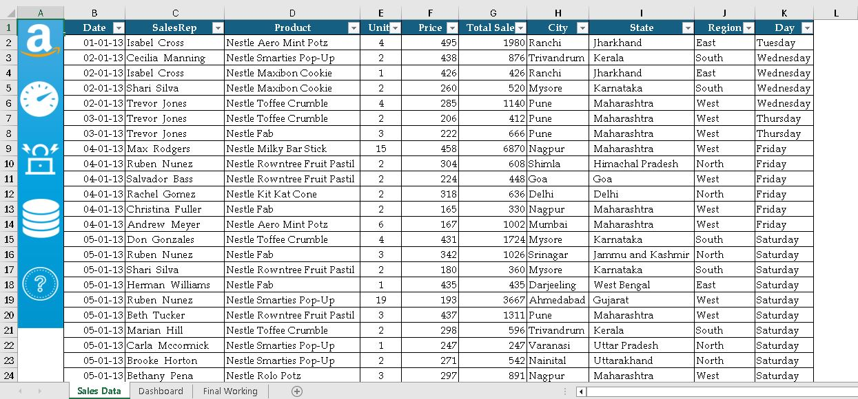
Adding Excel Data of Amazon Sales:

Slide 15
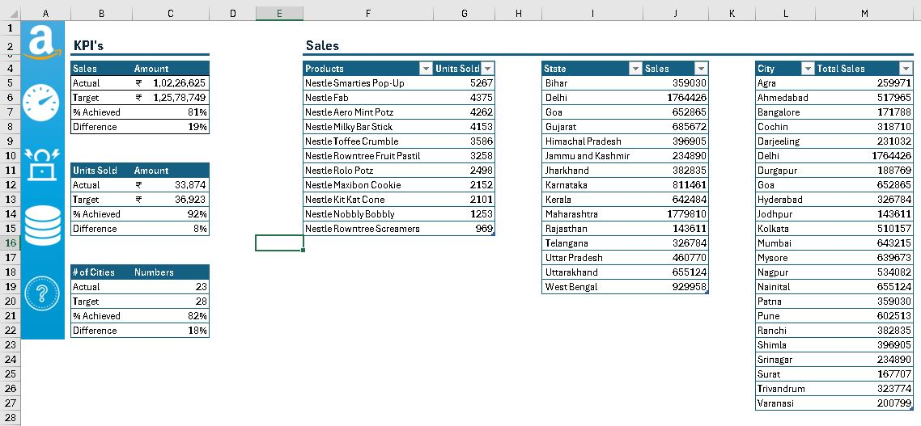
Adding KPI and Sales Data Pivot Slicers Sheet:

Slide 16
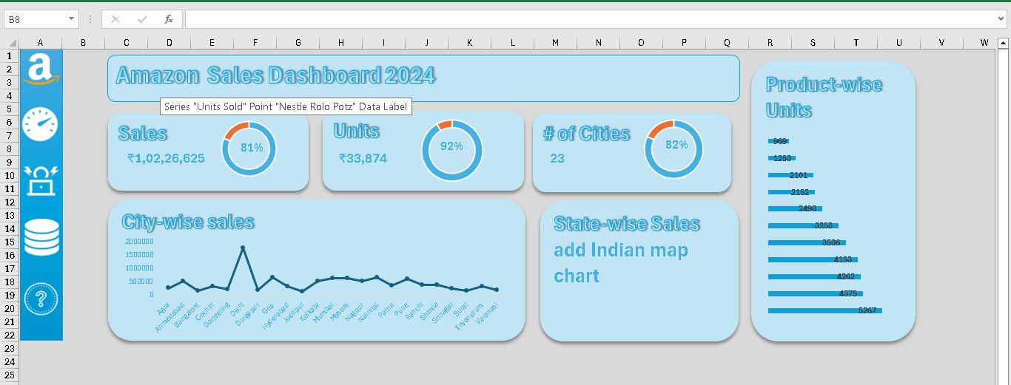
Adding Final Excel Amazon Dashboard:

Slide 17
Thank You for Viewing PPT.

